Slide 1
Module 3: Security
Deep Learning and Security
ML for Cybersecurity
Fall 2020

Slide 2
Learning Objective

Slide 3
Learning Objectives
Describe the considerations and challenges around choosing how to represent network data for analysis and modeling
Load network traffic that has been collected into software libraries
Represent your network data in ways that can be inputted into machine learning models

Slide 4
Deep Learning Overview

Slide 5








Overview of Deep Learning

Slide 6
The Goal of Deep Learning
Overcoming the limitations of linear models by applying the linear model to transformations on the features, x.
One approach: Apply a generic transformation (polynomial expansion, kernel machines such as radial basis, etc.)
Deep learning approach: Learn the transformation through multiple layers of transformations whose weights are adjusted in the training process.
Does not assume convexity. Often will not find the globally optimal result, but this is OK.

Slide 7







Basic Unit of Deep Learning: Neuron

Slide 8


















Multi-Layer Perceptron (Feed-Forward NN)

Slide 9



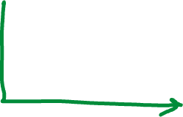



Activation Functions

Slide 10
Training Process: Backward/Forward Propagation
Training consists of iterations over epochs. One epoch:
Back propagation: Adjusting weights to correct error
Forward propagation: Evaluate outputs with adjusted weights
Steps
Select/compute weights (typically small initial weights)
Run model/compute output
Compute loss
Adjust weights to reduce loss (“back propagation”)

Slide 11
Output Activation
Output Activation Functions
Binary Classification: Sigmoid
Multiclass Classification: Softmax
Regression: No activation function
Loss Functions
Binary classification: Binary cross-entropy
Multiclass classification: Categorical cross-entropy
Regression: Mean squared error

Slide 12


Updating Weights (Backpropagation)
Change weight(s) a small amount to reduce loss after each iteration
How to change weights?
Back propagation (chain rule):

Slide 13
Deep Learning & Attack Detection

Slide 14
Case Study: Mirai Botnet Detection
Traffic patterns look different from normal
Can use a variety of unsupervised learning techniques for detection
Deep Learning is one such approach

Slide 15
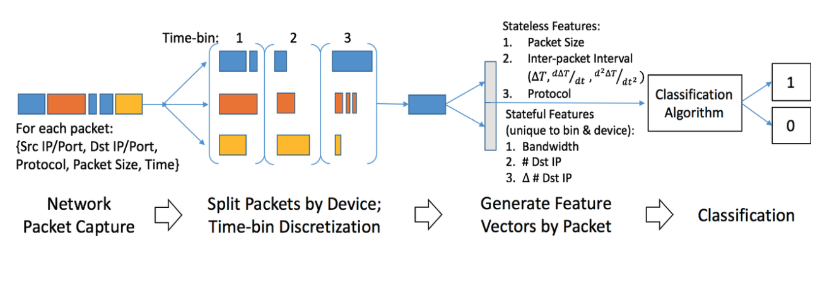

Slide 16
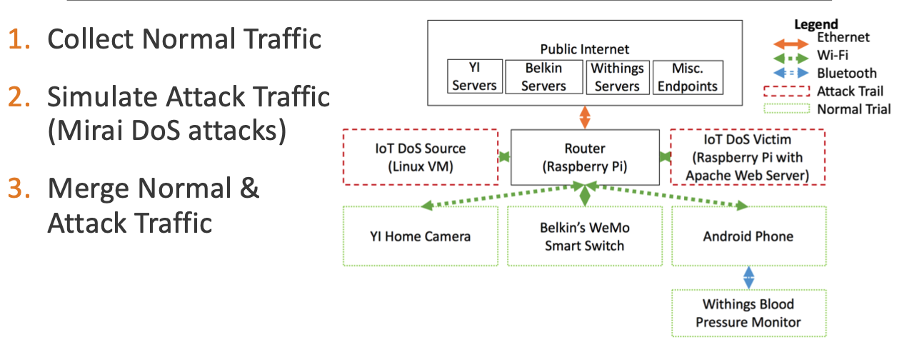

Slide 17
DEMONSTRATION: DENIAL OF SERVICE

Slide 18
